Slide 1
Software Controlled Drone
Presented By Kevin Libdan

Slide 2
Introduction
The main goal of this project was to control the drone with a NRF24L01 transceiver by capturing the drone’s transceiver signal and utilizing it to communicate with the NRF24L01 transceiver.

Slide 3
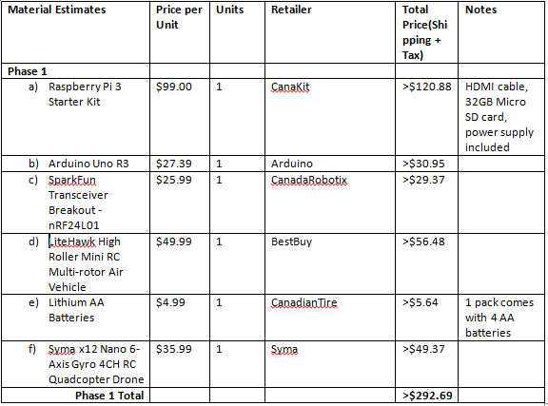
Updated Budget

Slide 4
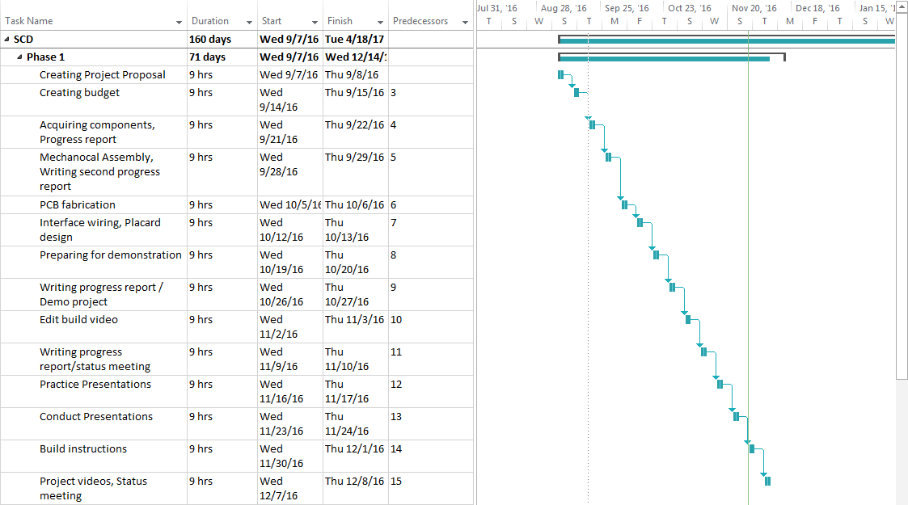
Project Schedule

Slide 5

Build Video

Slide 6
Knowledge Utilized From Previous Courses
CENG 215 – Digital and Interfacing Systems
TECH 153 – Technical C
CENG 216 – Introduction to Software Engineering

